Slide 1
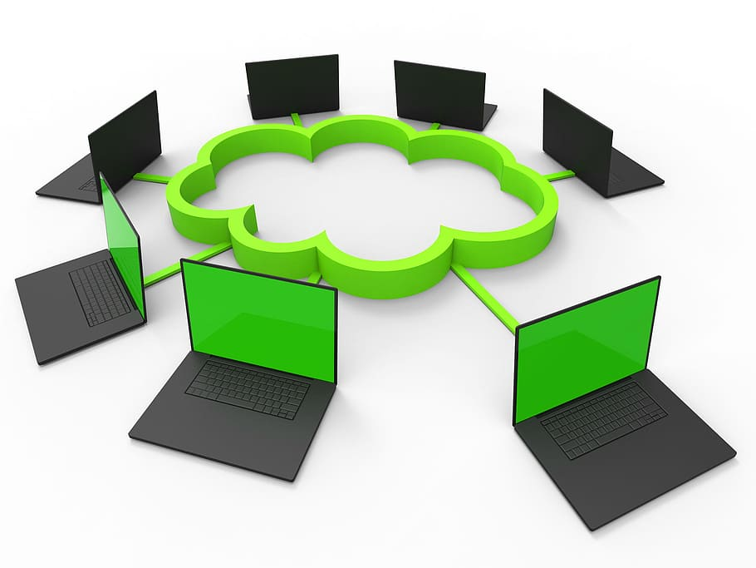
Open Source Cloud Computing
Seminar on
Sachin Rajbhar​, 41221139

Slide 2
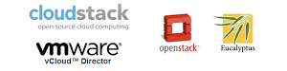
The power of Open Source is the power of people .The people rule.
“
”
Philippe

Slide 3
Cloud Computing
represents the “internet” i.e.
(Anywhere access of files , media)
to perform various tasks, including data processing, calculation, analysis, and communication.
(To do some task or
Perform an operation)

Slide 4
Flow
1
2
3
4
5
Introduction
Background
Types of Cloud
Types of Services
Advantage & Disdavantage

Slide 5
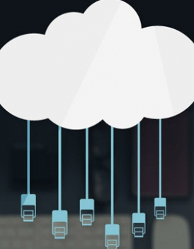
Introduction
Cloud Computing provides us a means by which we can access
Utilities
Applications
Hardware Resources
Database
With cloud computing users can access database resources via the internet from anywhere for as long as they need without worrying about any maintenance or management of actual resources.

Slide 6
Five Characteristics of Clouds
1. On-Demand Self-Service
2. Broad Network Access
3. Resource Pooling
4. Rapid Elasticity
5. Measured Service

Slide 7
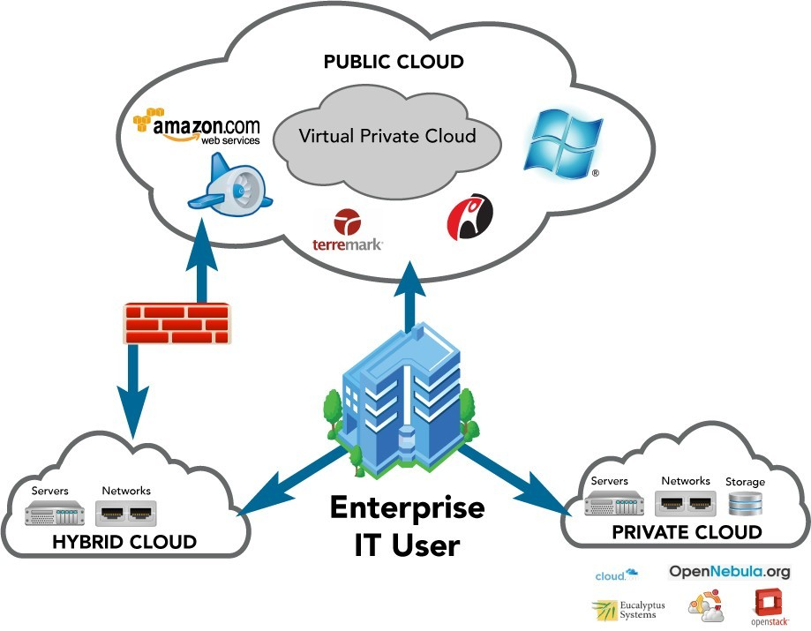
Deployment Models
Public, Private & Hybrid Clouds

Slide 8
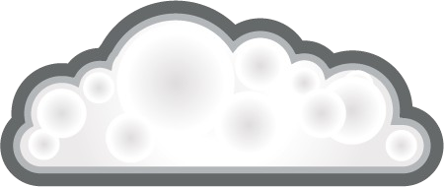
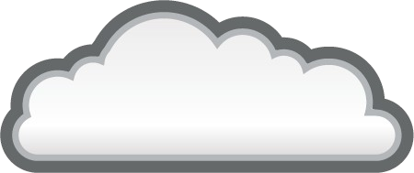

Cloud Computing Service Models
USER CLOUD a.k.a. SOFTWARE AS A SERVICE
SaaS
Single application, multi-tenancy, network-based, one-to-many delivery of applications, all users have same access to features.
Examples: Salesforce.com, Google Docs, Picasa
DEVELOPMENT CLOUD a.k.a. PLATFORM-AS-A-SERVICE
Application developer model, Application deployed to an elastic service that autoscales, low administrative overhead. No concept of virtual machines or operating system. Code it and deploy it.
PaaS
Examples: Google AppEngine, Windows Azure, Rackspace Site, Red Hat Makara/OpenShift, CloudFoundry
SYSTEMS CLOUD a.k.a INFRASTRUCTURE-AS-A-SERVICE
Servers and storage are made available in a scalable way over a network.
IaaS
Examples: EC2,Rackspace CloudFiles, OpenStack, CloudStack, Eucalyptus, Ubuntu Enterprise Cloud, OpenNebula

Slide 9

Why Open Source?
User-Driven Solutions to Real Problems Lower barrier to participation
Larger user base, users helping users
Aggressive release cycles stay current with the state-of- the-art
Open data, Open standards, Open APIs Avoids vendor lock-in

Slide 10


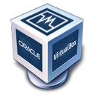
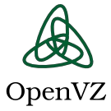
Open Source Hypervisors
Open Source
Xen, Xen Cloud Platform (XCP) KVM – Kernel-based Virtualization
VirtualBox* - Oracle supported Virtualization Solutions
OpenVZ* - Container-based, Similar to Solaris Containers or BSD Zones
LXC – User Space chrooted installs
Proprietary
VMware
Citrix Xenserver Microsoft Hyper-V
OracleVM (Based on OS Xen)

Slide 11
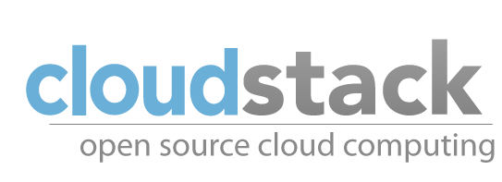

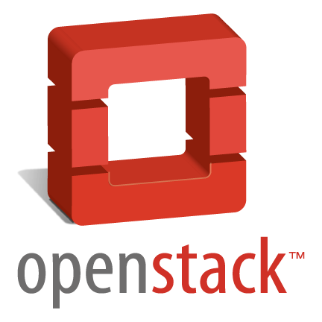
Open Source Compute Clouds
Year Started
License
Hypervisors Supported
Xenserver, XCP, KVM, Vmware, OVM, Hyper-V
Xen, KVM, VMware
2008
GPL
2006
GPL
2010
(Developed by
NASA by
Anso Labs previously)
Apache
VMware ESX and ESXi, Microsoft Hyper-V, Xen, KVM and Virtual Box and more
Other open source compute software include Abiquo, Red Hat’s CloudForms (Aeolus) and OpenNebula
Numerous companies are building cloud software on OpenStack including Nebula, Piston Inc.

Slide 12
Advantages
Disadvantages
Lower computer costs
Improved performance
Reduced software costs
Instant software updates
Unlimited Storage capacity
Increased Data Reliability
Easier group collaboration
Requires a constant internet connection
Doesn’t work well with low speed connections
Latency is there, so it is slow
Stored data might not be secure

Slide 13
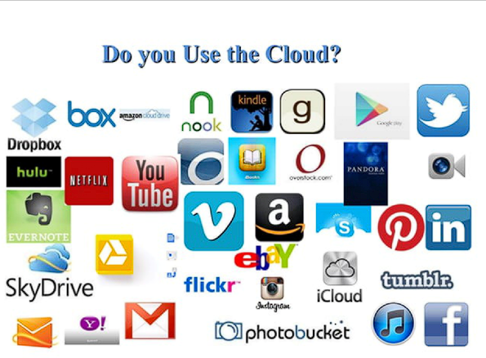

Slide 14

Thank you
Sachin Rajbhar
sr4205@dseu.ac.in
Sachinraj.in
This Photo by Unknown Author is licensed under CC BY-SA

